Slide 1
08 - Verbs in the driving seat
Nick Riches
Motivation for AS
5 min ex Valence
Thematic relations (roles)
08 - Verbs in the driving seat
Arg. Structure
Definition Determining valence
Do we need AS?
Projectionist Acc Probs with PA (1) Probs with PA (2) Probs with PA (3)
Nick Riches
Newcastle University
Propositions
What is a proposition?
November 20, 2019
Thematic relations
Main roles for Noun Phrases EXERCISE
Other roles for NPs
Roles for other types of phrases
Attributives Locatives
Instruments
A mnemonic
Further practice
Five min ex 1 / 41

Slide 2
08 - Verbs in the driving seat
Nick Riches
Motivation for argument structure
Motivation for AS
5 min ex Valence
Thematic relations (roles)
Argument Structure
Arg. Structure
Definition Determining valence
Do we need argument structure?
Propositions
Do we need AS?
Projectionist Acc Probs with PA (1) Probs with PA (2) Probs with PA (3)
Thematic relations (roles)
Propositions
What is a proposition?
Remembering thematic relations
Thematic relations
Main roles for Noun Phrases EXERCISE
Other roles for NPs
Roles for other types of phrases
Attributives Locatives
Further practice
Five minute exercise Bibliography
Instruments
A mnemonic
Further practice
Five min ex 1 / 41

Slide 3
5 minute exercise
08 - Verbs in the driving seat
Nick Riches
Motivation for AS
5 min ex Valence
Thematic relations (roles)
Arg. Structure
Definition Determining valence
What is wrong with the following sentences?
Do we need AS?
Projectionist Acc Probs with PA (1) Probs with PA (2) Probs with PA (3)
Jack gave Mary
Petula put the beans
Julie laughed Peter
Propositions
What is a proposition?
Thematic relations
Main roles for Noun Phrases EXERCISE
Other roles for NPs
Roles for other types of phrases
Attributives
Locatives
Instruments
A mnemonic
Further practice
Five min ex 2 / 41

Slide 4
Valence
08 - Verbs in the driving seat
Nick Riches
Motivation for AS
5 min ex Valence
Thematic relations (roles)
Arg. Structure
Definition Determining valence
Do we need AS?
Projectionist Acc Probs with PA (1) Probs with PA (2) Probs with PA (3)
Propositions
What is a proposition?
Thematic relations
Main roles for Noun Phrases EXERCISE
Drive
Donate
Mix
Yawn
Slap
Rain
Other roles for NPs
Roles for other types of phrases
Attributives Locatives Instruments
A mnemonic
Further practice
Five min ex 3 / 41

Slide 5
Valence
08 - Verbs in the driving seat
Nick Riches
Motivation for AS
5 min ex Valence
Thematic relations (roles)
Arg. Structure
Definition Determining valence
A verb ‘begs to be completed into a sentence’ (Tomasello, 1992)
The verb implies a certain number of participants (Valence) Valence can range from 0 to 3.
Do we need AS?
Projectionist Acc Probs with PA (1) Probs with PA (2) Probs with PA (3)
Propositions
What is a proposition?
Thematic relations
Main roles for Noun Phrases EXERCISE
Other roles for NPs
Roles for other types of phrases
Attributives Locatives Instruments
A mnemonic
Further practice
Five min ex 4 / 41

Slide 6
Valence
08 - Verbs in the driving seat
Nick Riches
Motivation for AS
5 min ex Valence
Thematic relations (roles)
Arg. Structure
Definition Determining valence
Psycholinguistic studies demonstrate that even when we hear verbs in isolation we mentally represent the number of participants (e.g. Shapiro et al. 1987 lexical decision task, or Kim & Thomson, 2000)
Do we need AS?
Projectionist Acc Probs with PA (1) Probs with PA (2) Probs with PA (3)
Propositions
What is a proposition?
Thematic relations
Main roles for Noun Phrases EXERCISE
Other roles for NPs
Roles for other types of phrases
Attributives Locatives Instruments
A mnemonic Further practice Five min ex 5 / 41

Slide 7
Thematic relations (roles)
08 - Verbs in the driving seat
Nick Riches
Motivation for AS
5 min ex Valence
Thematic relations (roles)
1. Jane fears
Peter
Arg. Structure
Definition Determining valence
2. Peter scares Jane
Do we need AS?
Projectionist Acc Probs with PA (1) Probs with PA (2) Probs with PA (3)
Paul liked the play
The play pleased Paul
Propositions
What is a proposition?
Mary gave
Pete received
Thematic relations
Main roles for Noun Phrases EXERCISE
Other roles for NPs
Roles for other types of phrases
Attributives Locatives
Pete |  | a present
 | a present |  | from Mary
Instruments
A mnemonic
Further practice
Five min ex 6 / 41

Slide 8
08 - Verbs in the driving seat
Nick Riches
Motivation for argument structure
Motivation for AS
5 min ex Valence
Thematic relations (roles)
Argument Structure
Arg. Structure
Definition Determining valence
Do we need argument structure?
Propositions
Do we need AS?
Projectionist Acc Probs with PA (1) Probs with PA (2) Probs with PA (3)
Thematic relations (roles)
Propositions
What is a proposition?
Remembering thematic relations
Thematic relations
Main roles for Noun Phrases EXERCISE
Other roles for NPs
Roles for other types of phrases
Attributives Locatives
Further practice
Five minute exercise Bibliography
Instruments
A mnemonic
Further practice
Five min ex 6 / 41

Slide 9
Definition
08 - Verbs in the driving seat
Nick Riches
Motivation for AS
5 min ex Valence
Thematic relations (roles)
Arg. Structure
Definition Determining valence
Argument Structure = a level of linguistic representation that comprises
Do we need AS?
Projectionist Acc Probs with PA (1) Probs with PA (2) Probs with PA (3)
the number of essential participants
their roles in the sentence
how those roles are ordered.
Propositions
What is a proposition?
Thematic relations
Main roles for Noun Phrases EXERCISE
Other roles for NPs
Roles for other types of phrases
Attributives
Locatives
Instruments
A mnemonic
Further practice
Five min ex 7 / 41

Slide 10
Definition
08 - Verbs in the driving seat
Nick Riches
Motivation for AS
5 min ex Valence
Thematic relations (roles)
Arg. Structure
Definition Determining valence
Do we need AS?
Projectionist Acc Probs with PA (1) Probs with PA (2) Probs with PA (3)
Essential participants are known as ‘arguments’
Propositions
What is a proposition?
Thematic relations
Main roles for Noun Phrases EXERCISE
Other roles for NPs
Roles for other types of phrases
Attributives Locatives Instruments
A mnemonic
Further practice
Five min ex 8 / 41

Slide 11
Definition
08 - Verbs in the driving seat
Nick Riches
Motivation for AS
5 min ex Valence
Thematic relations (roles)
Argument structure is partly semantic / partly syntactic:
Arg. Structure
Definition Determining valence
Semantic level: roles specified by the verb
Syntactic level: ordering of roles.
Do we need AS?
Projectionist Acc Probs with PA (1) Probs with PA (2) Probs with PA (3)
NB, role of subject, in particular is fixed, e.g.
Propositions
What is a proposition?
(1) She gave Patrick a cake
Thematic relations
Main roles for Noun Phrases EXERCISE
Other roles for NPs
(2) She gave a cake to Patrick
Roles for other types of phrases
Attributives Locatives Instruments
A mnemonic
Further practice
Five min ex 9 / 41

Slide 12
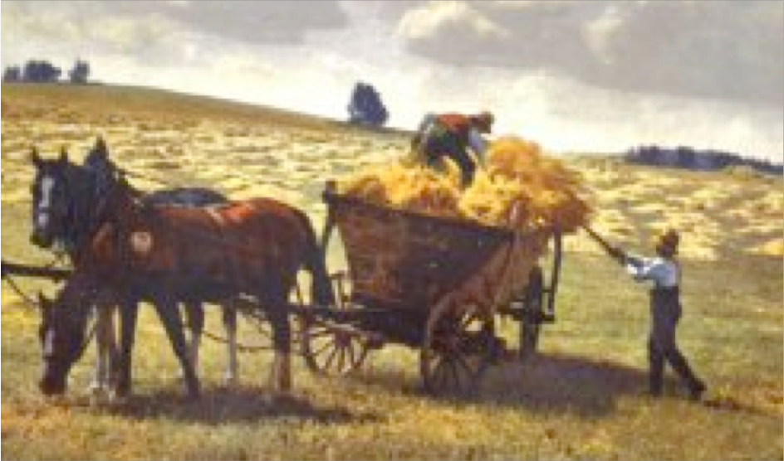
Definition
08 - Verbs in the driving seat
Nick Riches
Motivation for AS
5 min ex Valence
Thematic relations (roles)
SYNTAX
Syntactic frames
Adverbial
The man loaded the hay onto the wagon [with a pitch fork]
The man loaded the wagon with hay [with a pitch fork]
Arg. Structure
Definition Determining valence
X VERB-ed Y onto Z | X verb Z with Y (Alternation)
mapping / linking
Do we need AS?
Projectionist Acc Probs with PA (1) Probs with PA (2) Probs with PA (3)
ARGUMENT STRUCTURE
2
1 3
load <AGENT, PATIENT, LOCATION>
PRED < ARGUMENTS>
Propositions
What is a proposition?
Valency / thematic relations / thematic roles
Thematic relations
Main roles for Noun Phrases EXERCISE
Other roles for NPs Roles for other types of
SEMANTICS
phrases
Attributives Locatives Instruments
A mnemonic
Further practice
Five min ex10 / 41

Slide 13
Determining valence
08 - Verbs in the driving seat
Nick Riches
Motivation for AS
5 min ex Valence
Thematic relations (roles)
Arg. Structure
Definition Determining valence
How do we determine essential participants? Those which are obligatory?
Do we need AS?
Projectionist Acc Probs with PA (1) Probs with PA (2) Probs with PA (3)
* She dropped the pen
* She took the jacket
Propositions
What is a proposition?
Thematic relations
Main roles for Noun Phrases EXERCISE
Other roles for NPs
Roles for other types of phrases
Attributives Locatives Instruments
A mnemonic
Further practice
Five min ex11 / 41

Slide 14
Determining valence
08 - Verbs in the driving seat
Nick Riches
Motivation for AS
5 min ex Valence
Thematic relations (roles)
But most arguments can be rendered optional in certain contexts
Arg. Structure
Definition Determining valence
She gives (money) to charity
They all gave presents to Mary. Paul gave a pen (to Mary), Jenny gave a book (to Mary), and Brad gave a watch (to Mary)
COOKING INSTRUCTIONS: Chop (the carrots) and stir (them) into the sauce
Do we need AS?
Projectionist Acc Probs with PA (1) Probs with PA (2) Probs with PA (3)
Propositions
What is a proposition?
Thematic relations
Main roles for Noun Phrases EXERCISE
Other roles for NPs
Roles for other types of phrases
Attributives Locatives Instruments
A mnemonic
Further practice
Five min ex12 / 41

Slide 15
Determining valence
08 - Verbs in the driving seat
Nick Riches
Motivation for AS
5 min ex Valence
Thematic relations (roles)
In addition, some verbs seem to elicit a wide variety of arguments
Arg. Structure
Definition Determining valence
Do we need AS?
Projectionist Acc Probs with PA (1) Probs with PA (2) Probs with PA (3)
[ He ] paints [ walls ]
[ He ] painted [ the wall ] [ red ]
[ He ] painted [ the wall ] [ red ] [ with a paintbrush ] and [ some paint ]
[ This brush ] paints well
Propositions
What is a proposition?
Thematic relations
Main roles for Noun Phrases EXERCISE
Other roles for NPs
Roles for other types of phrases
Attributives Locatives Instruments
A mnemonic
Further practice
Five min ex13 / 41

Slide 16
Determining valence
08 - Verbs in the driving seat
Nick Riches
Motivation for AS
5 min ex Valence
Thematic relations (roles)
Arg. Structure
Definition Determining valence
Extra-valent arguments which sound “added on”
Do we need AS?
Projectionist Acc Probs with PA (1) Probs with PA (2) Probs with PA (3)
She swam [ ten lengths ]
They laughed [ the teacher ] [ out of the room ]
Propositions
What is a proposition?
Thematic relations
Main roles for Noun Phrases EXERCISE
Other roles for NPs
Roles for other types of phrases
Attributives Locatives Instruments
A mnemonic
Further practice
Five min ex14 / 41

Slide 17
Determining valence
08 - Verbs in the driving seat
Nick Riches
Motivation for AS
5 min ex Valence
Thematic relations (roles)
Arg. Structure
Definition Determining valence
Method 1: Corpus
Method 2: Introspection
Do we need AS?
Projectionist Acc Probs with PA (1) Probs with PA (2) Probs with PA (3)
These two methods can occasionally give different results! So there is no foolproof method
Propositions
What is a proposition?
Thematic relations
Main roles for Noun Phrases EXERCISE
Other roles for NPs
Roles for other types of phrases
Attributives Locatives
Instruments
A mnemonic
Further practice
Five min ex15 / 41

Slide 18
08 - Verbs in the driving seat
Nick Riches
Motivation for argument structure
Motivation for AS
5 min ex Valence
Thematic relations (roles)
Argument Structure
Arg. Structure
Definition Determining valence
Do we need argument structure?
Propositions
Do we need AS?
Projectionist Acc Probs with PA (1) Probs with PA (2) Probs with PA (3)
Thematic relations (roles)
Propositions
What is a proposition?
Remembering thematic relations
Thematic relations
Main roles for Noun Phrases EXERCISE
Other roles for NPs
Roles for other types of phrases
Attributives Locatives
Further practice
Five minute exercise Bibliography
Instruments
A mnemonic
Further practice
Five min ex15 / 41

Slide 19
The Projectionist Account
08 - Verbs in the driving seat
Nick Riches
Motivation for AS
5 min ex Valence
Thematic relations (roles)
Arg. Structure
Definition Determining valence
Do we need AS?
Projectionist Acc Probs with PA (1) Probs with PA (2) Probs with PA (3)
Why not just use the meaning of the verb to determine how it acts in a sentence?
Propositions
What is a proposition?
Thematic relations
Main roles for Noun Phrases EXERCISE
Other roles for NPs
Roles for other types of phrases
Attributives
Locatives
Instruments
A mnemonic
Further practice
Five min ex16 / 41

Slide 20
Problems with the Projectionist Account (1)
08 - Verbs in the driving seat
Nick Riches
Motivation for AS
5 min ex Valence
Thematic relations (roles)
Arg. Structure
Definition Determining valence
Jane
fears
Peter
Do we need AS?
Projectionist Acc Probs with PA (1) Probs with PA (2) Probs with PA (3)
Peter scare
Jane
The two verbs arguably have the same meaning but differ in order of realisation of arguments.
Propositions
What is a proposition?
Thematic relations
Main roles for Noun Phrases EXERCISE
Other roles for NPs
Roles for other types of phrases
Attributives Locatives Instruments
A mnemonic Further practice Five min ex17 / 41

Slide 21
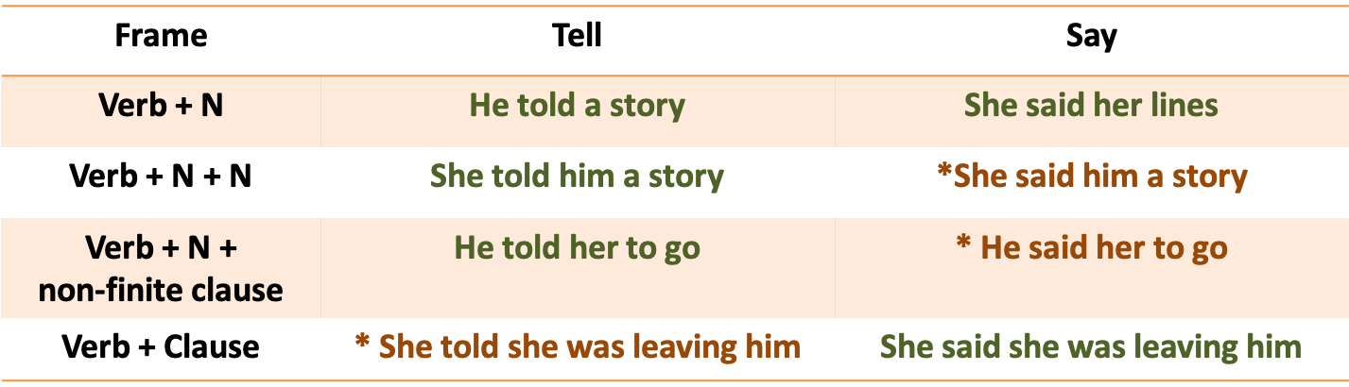
Problems with the Projectionist Account (2)
08 - Verbs in the driving seat
Nick Riches
Motivation for AS
5 min ex Valence
Thematic relations (roles)
Arg. Structure
Definition Determining valence
Do we need AS?
Projectionist Acc Probs with PA (1) Probs with PA (2) Probs with PA (3)
Propositions
What is a proposition?
The two verbs arguably have the same meaning but differ in terms of valence.
Thematic relations
Main roles for Noun Phrases EXERCISE
Other roles for NPs
Roles for other types of phrases
Attributives Locatives Instruments
A mnemonic
Further practice Five min ex18 / 41

Slide 22
Problems with the Projectionist Account (3)
08 - Verbs in the driving seat
Nick Riches
Motivation for AS
5 min ex Valence
Thematic relations (roles)
Arg. Structure
Definition Determining valence
1. He gave a book He gave her
to Mary
the book
Do we need AS?
Projectionist Acc Probs with PA (1) Probs with PA (2) Probs with PA (3)
2. He donated
a book
to the library
*He donated the library a book
Propositions
What is a proposition?
The two verbs have closely related meanings but differ in terms of their alternation characteristics (ability to occur in multiple frames)
Thematic relations
Main roles for Noun Phrases EXERCISE
Other roles for NPs
Roles for other types of phrases
Attributives Locatives
Instruments
A mnemonic
Further practice
Five min ex19 / 41

Slide 23
08 - Verbs in the driving seat
Nick Riches
Motivation for argument structure
Motivation for AS
5 min ex Valence
Thematic relations (roles)
Argument Structure
Arg. Structure
Definition Determining valence
Do we need argument structure?
Propositions
Do we need AS?
Projectionist Acc Probs with PA (1) Probs with PA (2) Probs with PA (3)
Thematic relations (roles)
Propositions
What is a proposition?
Remembering thematic relations
Thematic relations
Main roles for Noun Phrases EXERCISE
Other roles for NPs
Roles for other types of phrases
Attributives Locatives
Further practice
Five minute exercise Bibliography
Instruments
A mnemonic
Further practice
Five min ex19 / 41

Slide 24
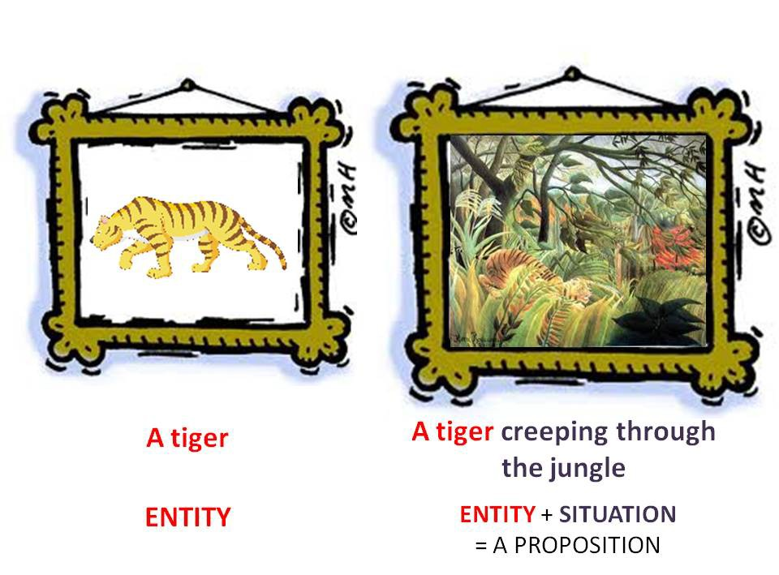
What is a proposition?
08 - Verbs in the driving seat
A mental scene involving at least one entity (or argument) participating in an event or situation
Nick Riches
Motivation for AS
5 min ex Valence
Thematic relations (roles)
Arg. Structure
Definition Determining valence
Do we need AS?
Projectionist Acc Probs with PA (1) Probs with PA (2) Probs with PA (3)
Propositions
What is a proposition?
Thematic relations
Main roles for Noun Phrases EXERCISE
Other roles for NPs
Roles for other types of phrases
Attributives Locatives Instruments
A mnemonic
Further practice
Five min ex20 / 41

Slide 25
What is a proposition?
08 - Verbs in the driving seat
Nick Riches
Motivation for AS
5 min ex Valence
Thematic relations (roles)
Contains those entities which make the most important contributions to the truth conditions of the sentence
Arg. Structure
Definition Determining valence
1. The dog chased the cat →
Do we need AS?
Projectionist Acc Probs with PA (1) Probs with PA (2) Probs with PA (3)
The robot washed the cat
TRUTH CONDITIONS HAVE COMPLETELY CHANGED
Propositions
What is a proposition?
2. The dog chased the cat →
Thematic relations
Main roles for Noun Phrases EXERCISE
Other roles for NPs
The dog quickly chased a cat
MINOR CHANGE TO TRUTH CONDITIONS
Roles for other types of phrases
Attributives Locatives Instruments
A mnemonic
Further practice
Five min ex21 / 41

Slide 26
What is a proposition?
08 - Verbs in the driving seat
Nick Riches
Motivation for AS
5 min ex Valence
Thematic relations (roles)
Proposition
chase(dog,cat)
Sentence
The dog chased the cat
It chased the cat
The cat was chased by the dog
Utterance
A: Is your dog energetic?
B: Well, it chases the neighbour’s cat every day!
Arg. Structure
Definition Determining valence
Do we need AS?
Projectionist Acc Probs with PA (1) Probs with PA (2) Probs with PA (3)
Propositions
What is a proposition?
Thematic relations
Main roles for Noun Phrases EXERCISE
Other roles for NPs
Roles for other types of phrases
Attributives
We need propositions to explain how different surface forms (e.g. 2) can have the same underlying meaning.
Locatives
The proposition IS the underlying meaning.
Instruments
A mnemonic
Further practice
Five min ex22 / 41

Slide 27
What is a proposition?
08 - Verbs in the driving seat
Nick Riches
Motivation for AS
5 min ex Valence
Thematic relations (roles)
Adverbial
SYNTAX The man loaded the hay onto the wagon [with a pitch fork]
Syntactic frames The man loaded the wagon with hay [with a pitch fork]
X VERB-ed Y onto Z | X verb Z with Y (Alternation)
Arg. Structure
Definition Determining valence
mapping / linking
Do we need AS?
Projectionist Acc Probs with PA (1) Probs with PA (2) Probs with PA (3)
ARGUMENT STRUCTURE
2
1 3
load <AGENT, PATIENT, LOCATION>
PRED < ARGUMENTS>
Propositions
What is a proposition?
Valency / thematic relations / thematic roles
Thematic relations
Main roles for Noun Phrases EXERCISE
Other roles for NPs
Roles for other types of phrases
Attributives
SEMANTICS
Locatives
Instruments
A mnemonic
Further practice
Five min ex23 / 41

Slide 28
08 - Verbs in the driving seat
Nick Riches
Motivation for argument structure
Motivation for AS
5 min ex Valence
Thematic relations (roles)
Argument Structure
Arg. Structure
Definition Determining valence
Do we need argument structure?
Propositions
Do we need AS?
Projectionist Acc Probs with PA (1) Probs with PA (2) Probs with PA (3)
Thematic relations (roles)
Propositions
What is a proposition?
Remembering thematic relations
Thematic relations
Main roles for Noun Phrases EXERCISE
Other roles for NPs
Roles for other types of phrases
Attributives Locatives
Further practice
Five minute exercise Bibliography
Instruments
A mnemonic
Further practice
Five min ex23 / 41

Slide 29












Main roles for Noun Phrases
Does entity deliberately initiate action?
(can we say “What X did was … “)
YES
NO
He fried the omelette They bought a house Jack drew a picture
Is entity affected (can we say "What
happened to X was ..."?)
AGENT
YES
NO
Is entity affected physically?
He had a dream
She asked a question
Angie performed a solo
Rufus criticized the plan
THEME
YES
NO
Albert ate a cake
She crashed the car The building collapsed
Ali felt tired Chen yawned Mary fears Peter
Peter scares Mary
PATIENT
EXPERIENCER

Slide 30
EXERCISE
08 - Verbs in the driving seat
Nick Riches
Motivation for AS
5 min ex Valence
Thematic relations (roles)
Charles crashed the car
Mavis heard the noise
The noise startled Mavis
The tree fell down in the storm
Ali considered the exciting proposal
Fatimah hated the start of term
The swing broke under his weight
The doctor felt the patient’s foot
I like having a bath with my clothes on
Jack liked Susan’s holiday snaps on Facebook.
Arg. Structure
Definition Determining valence
Do we need AS?
Projectionist Acc Probs with PA (1) Probs with PA (2) Probs with PA (3)
Propositions
What is a proposition?
Thematic relations
Main roles for Noun Phrases EXERCISE
Other roles for NPs
Roles for other types of phrases
Attributives
Locatives
Instruments
A mnemonic
Further practice
Five min ex25 / 41

Slide 31
EXERCISE
08 - Verbs in the driving seat
Nick Riches
Motivation for AS
5 min ex Valence
Thematic relations (roles)
1.
2.
3.
4.
5.
6.
7.
8.
9.
10.
crashed
Charles _{AG.}
the car _{PAT.}
Mavis _{EXP.} heard
the noise _{TH.}
Arg. Structure
Definition Determining valence
The noise _{TH.} startled
Mavis _{EXP.}
Do we need AS?
Projectionist Acc Probs with PA (1) Probs with PA (2) Probs with PA (3)
The tree _{PAT.} fell down in the storm
Ali _{AG.} considered
the exciting proposal _{TH.}
Fatimah _{EXP.} hated
the start of term _{TH.}
Propositions
What is a proposition?
The swing _{PAT.} broke under his weight
Thematic relations
Main roles for Noun Phrases EXERCISE
Other roles for NPs
Roles for other types of phrases
Attributives
The doctor _{AG.} felt
the patient’s foot _{TH.}
^{I} EXP.
like having a bath _{TH.} with my clothes on
Jack _{AG.}
liked on Facebook.
Susan’s holiday snaps _{TH.}
Locatives
Instruments
A mnemonic
Further practice
Five min ex26 / 41

Slide 32
Other roles for Noun Phrases
08 - Verbs in the driving seat
Nick Riches
Motivation for AS
5 min ex Valence
Thematic relations (roles)
Arg. Structure
Definition Determining valence
Benefactive is the role typically given to Indirect Object Noun Phrases, e.g.
Do we need AS?
Projectionist Acc Probs with PA (1) Probs with PA (2) Probs with PA (3)
1. She gave [ him _{BEN.} ] [ a book _{PAT.} ]
2. She bought [ a book _{PAT.} ] [ for him _{BEN.} ]
Propositions
What is a proposition?
Thematic relations
Main roles for Noun Phrases EXERCISE
Other roles for NPs
Roles for other types of phrases
Attributives
Locatives Instruments
A mnemonic
Further practice
Five min ex27 / 41

Slide 33
Other roles for Noun Phrases
08 - Verbs in the driving seat
Nick Riches
Motivation for AS
5 min ex Valence
Thematic relations (roles)
Arg. Structure
Definition Determining valence
Possessor is the owner of something
Do we need AS?
Projectionist Acc Probs with PA (1) Probs with PA (2) Probs with PA (3)
[ Jack _{POSS.} ] has/owns a Ferrari
The house belongs to [ Martha _{POSS.} ]
Propositions
What is a proposition?
Thematic relations
Main roles for Noun Phrases EXERCISE
Other roles for NPs
Roles for other types of phrases
Attributives Locatives Instruments
A mnemonic Further practice Five min ex28 / 41

Slide 34
Roles for other types of phrases
08 - Verbs in the driving seat
Nick Riches
Motivation for AS
5 min ex Valence
Thematic relations (roles)
Phrases which describe a property of something else are called ATTRIBUTIVES
ATTRIBUTIVES are mapped to Cs and Co.
Arg. Structure
Definition Determining valence
Do we need AS?
Projectionist Acc Probs with PA (1) Probs with PA (2) Probs with PA (3)
1. Janice feels happy _{ATTR}
Propositions
What is a proposition?
2. Losing at bingo makes Martha
^{sad} ATTR
Thematic relations
Main roles for Noun Phrases EXERCISE
3. Jack is in a mood _{ATTR}
Other roles for NPs
Roles for other types of phrases
Attributives Locatives Instruments
A mnemonic
Further practice
Five min ex29 / 41

Slide 35
Roles for other types of phrases
08 - Verbs in the driving seat
Nick Riches
Motivation for AS
5 min ex Valence
Thematic relations (roles)
Arg. Structure
Definition Determining valence
We can often make questions about attributives using the question word how, e.g.
Do we need AS?
Projectionist Acc Probs with PA (1) Probs with PA (2) Probs with PA (3)
1. Q: How does janice feel? A: Happy
Propositions
What is a proposition?
Thematic relations
Main roles for Noun Phrases EXERCISE
Other roles for NPs
Roles for other types of phrases
Attributives Locatives Instruments
A mnemonic
Further practice
Five min ex30 / 41

Slide 36
Roles for other types of phrases
08 - Verbs in the driving seat
Nick Riches
Motivation for AS
5 min ex Valence
Thematic relations (roles)
Arg. Structure
Definition Determining valence
Phrases which describe locations are sometimes called LOCATIVES, e.g.
Do we need AS?
Projectionist Acc Probs with PA (1) Probs with PA (2) Probs with PA (3)
1. Jason is in the park _{LOC}
2. Pat loaded the hay onto the wagon _{LOC}
Propositions
What is a proposition?
Thematic relations
Main roles for Noun Phrases EXERCISE
Other roles for NPs
Roles for other types of phrases
Attributives Locatives Instruments
A mnemonic Further practice Five min ex31 / 41

Slide 37
Roles for other types of phrases
08 - Verbs in the driving seat
Nick Riches
Motivation for AS
5 min ex Valence
Thematic relations (roles)
Arg. Structure
Definition Determining valence
A genuine argument?
Do we need AS?
Projectionist Acc Probs with PA (1) Probs with PA (2) Probs with PA (3)
1. The girls played baseball
in the park
Propositions
What is a proposition?
Thematic relations
Main roles for Noun Phrases EXERCISE
Other roles for NPs
Roles for other types of phrases
Attributives Locatives Instruments
A mnemonic Further practice Five min ex32 / 41

Slide 38
Roles for other types of phrases
08 - Verbs in the driving seat
Nick Riches
Motivation for AS
5 min ex Valence
Thematic relations (roles)
Arg. Structure
Definition Determining valence
We can make questions about locatives using the question word where, e.g.
Do we need AS?
Projectionist Acc Probs with PA (1) Probs with PA (2) Probs with PA (3)
1. Q: Where is Jason? A: In the park.
Propositions
What is a proposition?
Thematic relations
Main roles for Noun Phrases EXERCISE
Other roles for NPs
Roles for other types of phrases
Attributives Locatives Instruments
A mnemonic Further practice Five min ex33 / 41

Slide 39
Roles for other types of phrases
08 - Verbs in the driving seat
Nick Riches
Motivation for AS
5 min ex Valence
Thematic relations (roles)
Arg. Structure
Definition Determining valence
An instrument is an object used to perform and action, e.g.
Do we need AS?
Projectionist Acc Probs with PA (1) Probs with PA (2) Probs with PA (3)
1. Angela covered the food with a cloth _{INSTR}
Propositions
What is a proposition?
Thematic relations
Main roles for Noun Phrases EXERCISE
Other roles for NPs
Roles for other types of phrases
Attributives Locatives Instruments
A mnemonic Further practice Five min ex34 / 41

Slide 40
Roles for other types of phrases
08 - Verbs in the driving seat
Nick Riches
Motivation for AS
5 min ex Valence
Thematic relations (roles)
Arg. Structure
Definition Determining valence
A genuine thematic relation?
Do we need AS?
Projectionist Acc Probs with PA (1) Probs with PA (2) Probs with PA (3)
He hammered the nail (? with a hammer)
She filed her nails (with a nail file).
She scratched her back (with a loofah)
Propositions
What is a proposition?
Thematic relations
Main roles for Noun Phrases EXERCISE
Other roles for NPs
Roles for other types of phrases
Attributives Locatives
Instruments
A mnemonic
Further practice
Five min ex35 / 41

Slide 41
08 - Verbs in the driving seat
Nick Riches
Motivation for argument structure
Motivation for AS
5 min ex Valence
Thematic relations (roles)
Argument Structure
Arg. Structure
Definition Determining valence
Do we need argument structure?
Propositions
Do we need AS?
Projectionist Acc Probs with PA (1) Probs with PA (2) Probs with PA (3)
Thematic relations (roles)
Propositions
What is a proposition?
Remembering thematic relations
Thematic relations
Main roles for Noun Phrases EXERCISE
Other roles for NPs
Roles for other types of phrases
Attributives Locatives
Further practice
Five minute exercise Bibliography
Instruments
A mnemonic
Further practice
Five min ex35 / 41

Slide 42
08 - Verbs in the driving seat
Nick Riches
Motivation for AS
5 min ex Valence
Thematic relations (roles)
Arg. Structure
Definition Determining valence
After Eating Peas All Tiny Babies Avoid Laughing In Public
AGENT, EXPERIENCER, PATIENT, THEME, BENEFACTIVE, ATTRIBUTIVE, LOCATIVE, INSTRUMENT, POSSESSOR
Do we need AS?
Projectionist Acc Probs with PA (1) Probs with PA (2) Probs with PA (3)
Propositions
What is a proposition?
Thematic relations
Main roles for Noun Phrases EXERCISE
Other roles for NPs
Roles for other types of phrases
Attributives
Locatives
Instruments
A mnemonic
Further practice
Five min ex36 / 41

Slide 43
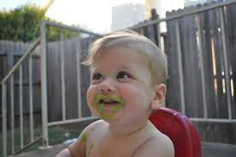
08 - Verbs in the driving seat
Nick Riches
Motivation for AS
5 min ex Valence
Thematic relations (roles)
Arg. Structure
Definition Determining valence
Do we need AS?
Projectionist Acc Probs with PA (1) Probs with PA (2) Probs with PA (3)
Propositions
What is a proposition?
Thematic relations
Main roles for Noun Phrases EXERCISE
Other roles for NPs
Roles for other types of phrases
Attributives Locatives
Instruments
A mnemonic
Further practice
Five min ex37 / 41

Slide 44
08 - Verbs in the driving seat
Nick Riches
Motivation for argument structure
Motivation for AS
5 min ex Valence
Thematic relations (roles)
Argument Structure
Arg. Structure
Definition Determining valence
Do we need argument structure?
Propositions
Do we need AS?
Projectionist Acc Probs with PA (1) Probs with PA (2) Probs with PA (3)
Thematic relations (roles)
Propositions
What is a proposition?
Remembering thematic relations
Thematic relations
Main roles for Noun Phrases EXERCISE
Other roles for NPs
Roles for other types of phrases
Attributives Locatives
Further practice
Five minute exercise Bibliography
Instruments
A mnemonic
Further practice
Five min ex37 / 41

Slide 45
08 - Verbs in the driving seat
Nick Riches
Motivation for AS
5 min ex Valence
Thematic relations (roles)
Jack considers himself a real gigolo
Angie sent her father the bundle of letters last Tuesday
The steering wheel came off in his hands
Jance watched the hovering buzzard
Who does this pencil case belong to?
Jake painted the wall with red paint.
Alina smelt the beautiful flowers
Arg. Structure
Definition Determining valence
Do we need AS?
Projectionist Acc Probs with PA (1) Probs with PA (2) Probs with PA (3)
Propositions
What is a proposition?
Thematic relations
Main roles for Noun Phrases EXERCISE
Other roles for NPs
Roles for other types of phrases
Attributives
Locatives
Instruments
A mnemonic
Further practice
Five min ex38 / 41

Slide 46
08 - Verbs in the driving seat
Nick Riches
Motivation for AS
5 min ex Valence
Thematic relations (roles)
1.
2.
considers
Arg. Structure
Definition Determining valence
Jack _{EXP.}
 | himself _{TH.} |  | a real gigolo _{ATTR.}
her father _{BEN.} |  | the bundle of letters _{PAT.}
Angie _{AG.}
sent
last Tuesday
Do we need AS?
Projectionist Acc Probs with PA (1) Probs with PA (2) Probs with PA (3)
3.
4.
5.
6.
7.
came off in his hands
The steering wheel _{PAT.}
Jance _{AG.}
watched
the hovering buzzard _{TH.}
Propositions
What is a proposition?
^{Who} POSS.
does th
is pencil _{TH.}
case belong to?
.
Thematic relations
Main roles for Noun Phrases EXERCISE
Other roles for NPs
Roles for other types of phrases
Attributives Locatives
Jake _{AG.}
painted
the wall _{PAT.}
with red paint _{INS.}
Alina _{AG.}
smelt
the beautiful flowers _{TH.}
Instruments
A mnemonic
Further practice
Five min ex39 / 41

Slide 47
08 - Verbs in the driving seat
Nick Riches
Motivation for argument structure
Motivation for AS
5 min ex Valence
Thematic relations (roles)
Argument Structure
Arg. Structure
Definition Determining valence
Do we need argument structure?
Propositions
Do we need AS?
Projectionist Acc Probs with PA (1) Probs with PA (2) Probs with PA (3)
Thematic relations (roles)
Propositions
What is a proposition?
Remembering thematic relations
Thematic relations
Main roles for Noun Phrases EXERCISE
Other roles for NPs
Roles for other types of phrases
Attributives Locatives
Further practice
Five minute exercise Bibliography
Instruments
A mnemonic
Further practice
Five min ex39 / 41

Slide 48
08 - Verbs in the driving seat
Nick Riches
Motivation for AS
5 min ex Valence
Thematic relations (roles)
Arg. Structure
Definition Determining valence
How many possible ways can you think of to complete the following sentence?
(NB think of how many different syntactic structures can be used after verb)
Do we need AS?
Projectionist Acc Probs with PA (1) Probs with PA (2) Probs with PA (3)
Propositions
What is a proposition?
1. Doctor Who remembered . . .
Thematic relations
Main roles for Noun Phrases EXERCISE
Other roles for NPs
Roles for other types of phrases
Attributives
Locatives
Instruments
A mnemonic
Further practice
Five min ex40 / 41

Slide 49
08 - Verbs in the driving seat
Nick Riches
Motivation for argument structure
Motivation for AS
5 min ex Valence
Thematic relations (roles)
Argument Structure
Arg. Structure
Definition Determining valence
Do we need argument structure?
Propositions
Do we need AS?
Projectionist Acc Probs with PA (1) Probs with PA (2) Probs with PA (3)
Thematic relations (roles)
Propositions
What is a proposition?
Remembering thematic relations
Thematic relations
Main roles for Noun Phrases EXERCISE
Other roles for NPs
Roles for other types of phrases
Attributives Locatives
Further practice
Five minute exercise Bibliography
Instruments
A mnemonic
Further practice
Five min ex40 / 41

Slide 50
08 - Verbs in the driving seat
Nick Riches
Motivation for AS
5 min ex Valence
Thematic relations (roles)
Kim, M., & Thompson, C. K. (2000). Patterns of comprehension and production of nouns and verbs in agrammatism: implications for lexical organisation. Brain and Language, 74, 1-25.
Shapiro, L. P., Zurif, E., & Grimshaw, J. (1987). Sentence processing and the mental representation of verbs.
Cognition, 27(3), 219-246. https://doi.org/10.1016/S0010-0277(87)80010-0
Arg. Structure
Definition Determining valence
Do we need AS?
Projectionist Acc Probs with PA (1) Probs with PA (2) Probs with PA (3)
Propositions
What is a proposition?
Thematic relations
Main roles for Noun Phrases EXERCISE
Other roles for NPs
Roles for other types of phrases
Attributives
Locatives
Instruments
A mnemonic
Further practice
Five min ex41 / 41

